Slide 1
Revision Notes...
  These notes cover some important software engineering topics – but any topic covered in your notes or in your lectures is a possible subject for an exam question (so yes – you should read all of your notes!)
  This year’s exam will be a 60-minute on-line multiple choice examination.
  A sample of multiple choice questions is now available on-line for you to try: log in to Queen’s Online and click CSC2018-SPR-QUB; click Assessment, and follow the link “continue to Questionmark assessment”

Slide 2
Software Process

Slide 3
Software process models
Waterfall model
  Separate and distinct phases of specification and development
Spiral Model and...
Incremental and Iterative Models
  Specification and development are interleaved
  Various versions
  Agile Methods
Formal transformation
  A mathematical system model is formally transformed to an implementation
Reuse-based development
  The system is assembled from existing components

Slide 4
Waterfall model (Royce)
Requirements Definition
Design
Implementation
Verification & Validation
Installation
Operation & Maintenance

Slide 5
Problems with the Waterfall Model?
Managers love waterfall models:
  Nice milestones
  No need to look back (linear system), one activity at a time
  Easy to check progress : 90% coded, 20% tested
But, most software development is iterative
  During design, problems with requirements are identified
  During coding, design and requirement problems are found
  During testing, coding, design& requirement errors are found
System development is a nonlinear activity
  Often have to revisit and rework previous tasks
Verification and Validation (Testing) comes too late
(very risky!)

Slide 6
Evolutionary Strategies
Main purpose of software process model is “to give risk-reducing structure” [Ould, 1990].
Growing recognition that in many cases software should be developed in an evolutionary fashion [e.g. McConnell, 1993]
e.g. Microsoft Visual C++ is shipped every 4 months
Agile Methods (more later) are all evolutionary
Software is “grown” rather than “built”
Ould, M.A., Strategies for Software Engineering: The Management of Risk and Quality, John Wiley, NY, 1990.
McConnell, S., Rapid Development: Taming Wild Software Schedules, Microsoft Press, Redmond, WA, 1996

Slide 7
Evolutionary models
Waterfall is poor at managing risk
Waterfall assumes that all requirements can be obtained upfront
Prototyping could provide the answer
  Throwaway prototyping = building a prototype just to test a hypothesis.
    In Extreme Programming this is known as a spike. Then build the real product.
  Evolutionary Prototyping – build a prototype as a demonstrator,
  then use it as a base to build the full functionality
  Prototyping particularly common in designing GUI’s
  Lower risk since testing is very early! Risk is spread out.
Difficulties?
  Planning
  Managers don’t like it
  No guarantee that the end will be reached
  Architecture could get messy – need for rework

Slide 8
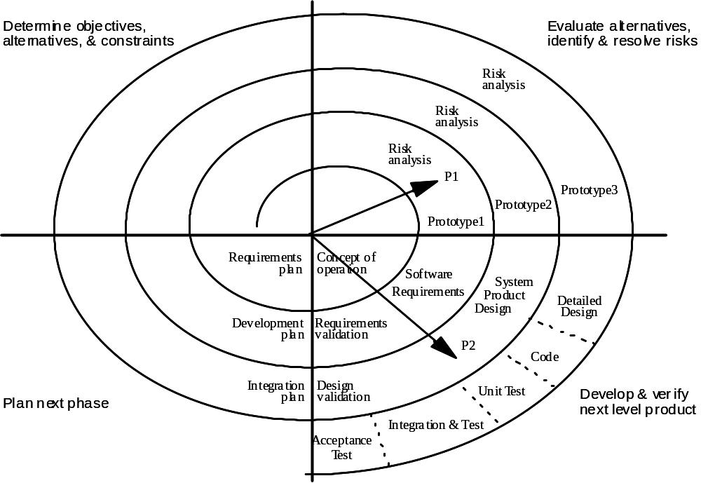
Spiral Model (Boehm 1987)
*
Note:
This is an example of how the spiral model might work
* = start

Slide 9
Spiral Model
1
Determine objectives, alternatives, constraints
2
Evaluate alternatives, identify and resolve risks
4
Plan Next Phase
Develop & verify next level product
3
cost
time

Slide 10
Spiral Model – risk
To understand the spiral model we need to understand risk
Risk = the possibility that some loss is incurred
Risk Exposure (RE) = probability * loss
Risk Analysis
  Risk Identification
  Risk Assessment (RE)
  Risk Prioritisation = ranking
  Risk Resolution = accept it OR reduce it OR avoid it
  Risk Monitoring = where a risk is accepted watching possible triggers that might cause the risk

Slide 11
Spiral Model
The spiral model is an iterative model with the following activities:
  Determine objectives, alternatives and constraints (1st quadrant)
  Evaluate Alternatives (2nd quadrant)
  Identify risks (2nd quadrant)
  Resolve risks (2nd quadrant)
  If a certain risk cannot be resolved satisfactorily,
  terminate the project (2nd quadrant)
  Develop a series of prototypes for the identified risks starting with the highest risk. (2nd quadrant)
    Aim is to make sure the highest risks are dealt with
  Use a waterfall model (incremental may also be appropriate) for each next-level product development (3rd quadrant)
  Evaluate the results of the “cycle” and plan the next round (4th quadrant)

Slide 12
Iterative and Incremental Development (IID)*
What, how, why?
Iteration 1
Interation 1
Set of Requirements
Interation 2
Iteration 2
Iteration 3
Interation 3
Why is this good?
*of which the Spiral Model is an example
Notes:
Match with iCORE focus areas.
Pervasive character of software

Slide 13
Iterative and Incremental Development (IID)
What, how, why?
Iteration 1
Interation 1
Set of Requirements
Interation 2
Iteration 2
Iteration 3
Interation 3
Better Estimates
Better Time to Market for high priority
Easier Reaction to change
Early Feedback
Lower risk
Notes:
Match with iCORE focus areas.
Pervasive character of software

Slide 14
Software Process Maturity
A software development process is mature
  if the development activities are well defined and
  if management has some control over the quality, budget and schedule of the project
Process maturity is described with
  a set of maturity levels and
  the associated measurements (metrics) to manage the process
Assumption:
  With increasing maturity the risk of project failure decreases

Slide 15
SEI Capability Maturity Level
1. Initial Level
  also called ad hoc or chaotic
2. Repeatable Level
  Process depends on individuals ("champions")
3. Defined Level
  Process is institutionalized (sanctioned by management)
4. Managed Level
  Activities are measured and provide feedback for resource allocation (process itself does not change)
5. Optimizing Level
  Process allows feedback of information to change process itself

Slide 16
CMM Level 1 – Initial
Capability Maturity Model
Ad hoc approach to software development activities
No problem statement or requirements specification
Inputs and Outputs not defined in advance
Output is expected
  but nobody knows how to get there in a deterministic fashion
Similar projects may vary widely in productivity

Slide 17
CMM Level 2 - Repeatable
Inputs and outputs are defined
  Input: Problem statement or requirements specification
  Output: Source code
Process itself is a black box
(activities within process are not known)
  No intermediate products are visible
  No intermediate deliverables
  Project Plan is used and tracked
  All deliverables and processes reviewed (QA role)
  Configuration Management exists

Slide 18
CMM Level 3 - Defined
Defined software process on all projects
Personnel assigned to improve process (E.g. QA team)
Activities of software development process are well defined with clear entry and exit conditions.
Intermediate products of development are well defined
and visible
Peer reviews

Slide 19
CMM Level 4 - Managed
Quantitative Process Management
  Productivity and quality metrics defined and constantly measured
Quality Management
  Organisation has quality goals and monitors these
Uses information from early project activities to set priorities for later project activities (intra-project feedback)
  The feedback determines how and in what order
  resources are deployed
Effects of changes in one activity
can be tracked in the others

Slide 20
CMM Level 5 - Optimising
Measures from software development activities are used to change and improve the current process
This change can affect both the organization and the project:
  The organization might change its management scheme
  A project may change its process model before completion

Slide 21
Software Project Management

Slide 22
Function Point Analysis (FPA)
The following system components are considered
  Number of external inputs (e.g. input files of transactions) (I)
  Number of external outputs (e.g. output files of reports, messages) (O)
  Number of user interactions / enquiries (e.g. menu selection, queries...) (E)
  Number of internal or logical files used by the system (L)
  Number of external or interface files shared with other applications (IF)
In each case, depending on the number of field types associated with each component, and the variety of file types that these elements refer to, these components are rated as simple, average or complex

Slide 23
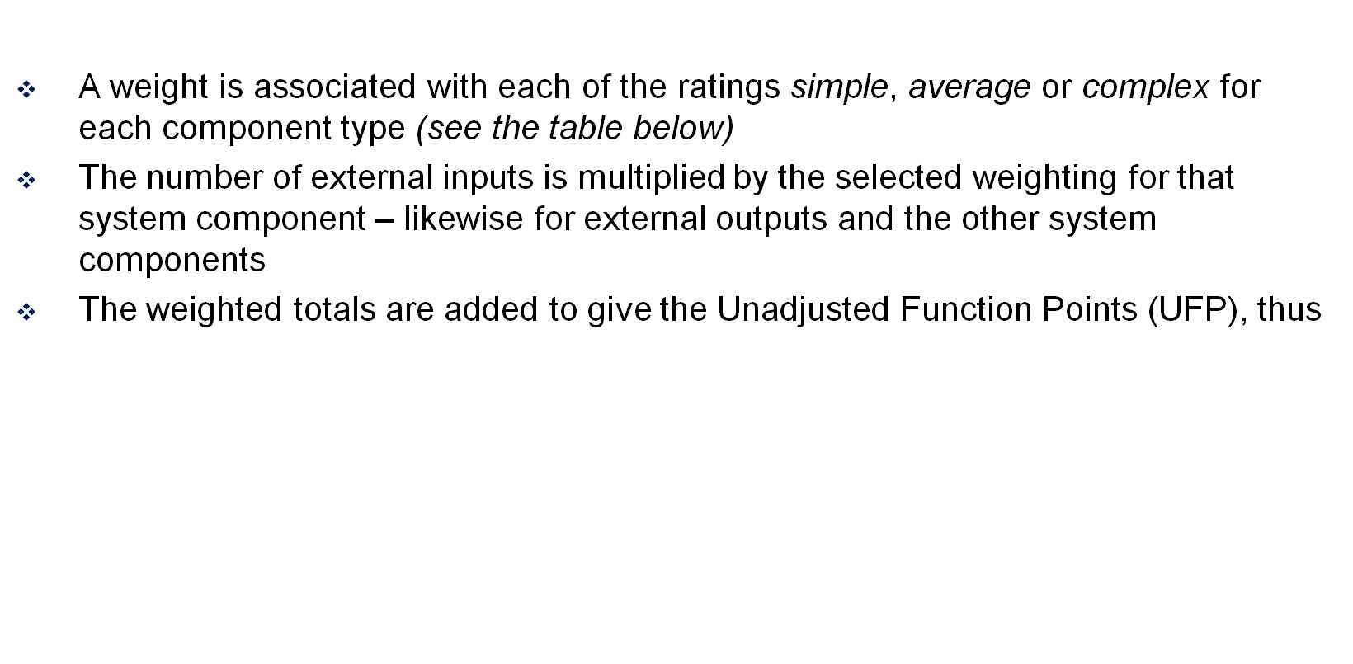
Function Point Analysis (FPA) contd
UFP = Σ Input(w_{i} ) + Σ Output(w_{o} ) + Σ Enquiry(w_{e} )
+ Σ Logical File(w_{l} ) + Σ Interface File( w_{if} )
COMPONENT | COMPLEXITY LEVEL
 | simple | average | complex
Input (I) | ×3 | ×4 | ×6
Output (O) | ×4 | ×5 | ×7
Enquiry (E) | ×3 | ×4 | ×6
Internal (Logical) File (L) | ×7 | ×10 | ×15
Interface File (IF) | ×5 | ×7 | ×10

Slide 24
Function Point Analysis (FPA) contd
UFP is then adjusted to take account of the type of application
  This adjustment is made by multiplying UFP
  by a Technical Complexity Factor, TCF
  As preparation for calculating TCF, 14 General System Characteristics (GSCs) are scored for Degree of Influence from 0 (no influence) to 5 (strong influence):
    data communications, distributed functions, performance, heavily used configuration, transaction rate, on-line data entry, end-user efficiency, on-line update, complex processing, reusability, installation ease, operational ease, multiple sites, facilitate change
  TCF is then calculated as follows:
  TCF = 0.65 + 0.01×DI where
    DI = the total Degree of Influence from the 14 scored characteristics

Slide 25
Function Point Analysis (FPA) contd
A comment on the TCF calculation, also known as the Value Adjustment Formula or VAF:
  The top score from the General System Characteristics is 14 × 5 = 70
  A normal or moderate score (where collectively the GSCs are midway between ‘no influence’ and ‘strong influence’) would be 14 × 2.5 = 35
  We need to make this case, where the GSCs total 35, the case where the Technical Complexity Factor = 1, and therefore has no effect as a multiplier on the Unadjusted Function Points (UFP)
  One way to achieve this is to multiply 35 by 0.01 and then add 0.65
  That is the basis of the VAF!
  Consider an application whose GSCs total 45
    45 × 0.01 + 0.65 = 1.1
    Such an application is 0.1 more complex than normal and its Technical Complexity Factor of 1.1 reflects this.

Slide 26
FPA: Function points in practice
But there are some difficulties:
  FPs – and particularly the scores given to the General System Characteristics – are very subjective: they cannot be counted automatically and depend on the analyst’s assessment
  There are only 3 complexity levels for weighting the functionality of the main system components
  The approach has to be calibrated or adjusted for different programming tasks and environments
  Ultimately experience will tell how well the approach is working: does 1 FP really match 32 lines of VB?

Slide 27
COCOMO: algorithmic cost modelling
Cost is estimated as a mathematical function of product, project and process attributes
The function is derived from a study of historical costing data
The most commonly used product attribute for cost estimation is LOC (lines of code or code size)
One widely used costing model is COCOMO
– Constructive Cost Model
COCOMO exists in three forms
  Basic - gives a rough estimate based on product attributes
  Intermediate - modifies the basic estimate using project and process attributes
  Advanced - estimates project phases and parts separately

Slide 28
COCOMO
The class of project affects the multipliers
and exponents used in basic COCOMO
3 classes of project are recognised
  Simple (or Organic): small teams, familiar environment, well-understood applications, no difficult non-functional requirements
  Moderate (or Semi-detached): project team may have experience mixture, system may have more significant non-functional constraints, organisation may have less familiarity with application
  Embedded: hardware/software systems, tight constraints, unusual for team to have deep application experience
Formulae for basic COCOMO : E = a × KDSI^{b}; D = 2.5 × E^{c}
  E = Effort in Person-months
  Values for a ,b & c are based on project class & historical data
  D = development time in months *
  KDSI = Thousands of Delivered Source Instructions
    Delivered Source Instructions ≈ Lines of Code
*same formula for D used with Intermediate COCOMO

Slide 29
COCOMO
Remember, the multipliers and exponents for basic COCOMO’s formulae change according to the class of project:
Variables
Project Class a b c
Organic 2.4 1.05 0.38
Semi-detached 3.0 1.12 0.35
Embedded 3.6 1.30 0.32
Example:
Organic mode: 42,000 delivered source instructions
E = 2.4 × 42 ^{1.05}
= 121.5 person months
D = 2.5 × 121.5 ^{0.38}
= 15.5 months
No. Personnel = E/D = 7.8
Formulae for basic COCOMO : E = a × KDSI^{b}; D = 2.5 × E^{c}
  E = Effort in Person-months
  Values for a ,b & c are based on project class & historical data
  D = development time in months
  KDSI = Thousands of Delivered Source Instructions
  (~Lines of Code)

Slide 30
Intermediate COCOMO
Intermediate COCOMO takes the Basic COCOMO formula a × KDSI^{b}
as its starting point
  In intermediate COCOMO the value a is equal to 3.2, 3.0 and 2.8, for organic,
  semi-detached and embedded projects respectively.
Additionally Intermediate COCOMO identifies personnel, product,
computer and project attributes which affect cost
With intermediate COCOMO, the basic cost is adjusted by attribute multipliers: presently we’ll give values to a sample of these multipliers:
1. Product attributes
• Required software reliability (RELY)
• Database size (DATA)
• Product complexity (CPLX)
2. Computer Attributes
• Execution time constraints (TIME)
• Storage constraints (STOR)
• Virtual machine volatility (VIRT)
• Computer turnaround time (TURN)

Slide 31
Intermediate COCOMO
3. Personnel Attributes
• Analyst capability (ACAP)
• Programmer capability (PCAP)
• Applications experience (AEXP)
• Virtual machine experience (VEXP)
• Programming language experience (LEXP)
4. Project Attributes
• Modern programming practices (MODP)
• Software tools (TOOL)
• Required development schedule (SCED)
These are attributes which were found to be significant in one organisation with a limited project history database
Other attributes may be more significant for other projects and other organisations

Slide 32
Example: Embedded Software
Scenario: development of embedded software system on microcomputer hardware.
Assume that Intermediate COCOMO formula a × KDSI^{b} predicts a 45 person-month effort.
The following attributes (with the multiplier values shown) are relevant to the organisation
RELY (1.15), STOR (1.21), TIME (1.10), TOOL (1.10), VEXP(1)
Intermediate COCOMO therefore predicts
  45 × 1.15 × 1.21 × 1.1 × 1.1 × 1 = 75.77 person months
At £3,000 per person-month this means a total cost of £227,310
Alternative 1: Use a faster CPU and more memory to reduce TIME and STOR attribute multipliers (though there will be less software support)
Alternative 2: Buy some software tools (CASE tools) to reduce the TIME and TOOL multipliers (though more virtual machine experience will be needed)

Slide 33
Alternative 1: Faster Machine
Say processor capacity and storage are increased
(corresponding multipliers decrease)
  TIME and STOR multipliers = 1
  RELY still 1.15
Say fewer tools are available (corresponding multiplier increased)
  TOOL = 1.24
Extra investment of £30,000 required for the faster machine
Staff cost = 45 × 1.24 × 1.15 = 64.17 Person-months = £192,510
Total cost = £192,510 + £30,000 = £222,510
Cost saving = £227,310 – £222,510 = £4,800

Slide 34
Alternative 2: Better tools
Extra investment of £15,000 required for the software tools
Reduces TIME multiplier (down to 1)
and TOOL multiplier (down to 1)
Increases VEXP multiplier to 1.1
RELY still 1.15, STOR still 1.21
Staff Cost = 45 × 1.15 × 1.21 × 1.1 = 68.88 person-months = £206,640
Total Cost = £15,000 + £206,640 = £221,640
Cost Saving = £227,310 - £221,640 = £5,670
ALTERNATIVE 2 is best

Slide 35
Work Breakdown Structure
The hierarchical representation of all the tasks in a project is called the work breakdown structure (WBS)
First Version of a UML Model…
But Tasks are Parts of Activities – so are there more granular representations of the project that make clear the relationships between activities and tasks?

Slide 36
Creating Work Breakdown Structures
Two major philosophies
  Activity-oriented decomposition (“Functional decomposition“)
    Write the book
    Get it reviewed
    Do the suggested changes
    Get it published
  Result-oriented (“Object-oriented decomposition“)
    Chapter 1
    Chapter 2
    Chapter 3

Slide 37
Project Scheduling
Work Breakdown Structures
  Divide the project up into tasks
OnLine Frequent Flyer Points
Obtain Funding
Client Side Code
Implement Database
Screen Designs
Validation
Linking to Server Side
Main Applet
Authorisation Code
Account Balance
System Testing
Calculate Account Balance
Display Account Balance
Release

Slide 38
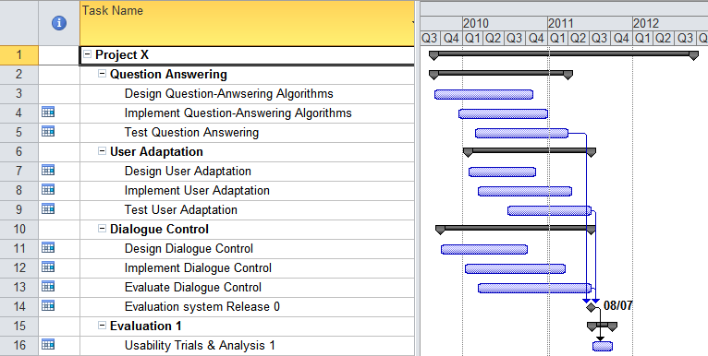
Gantt Chart

Slide 39
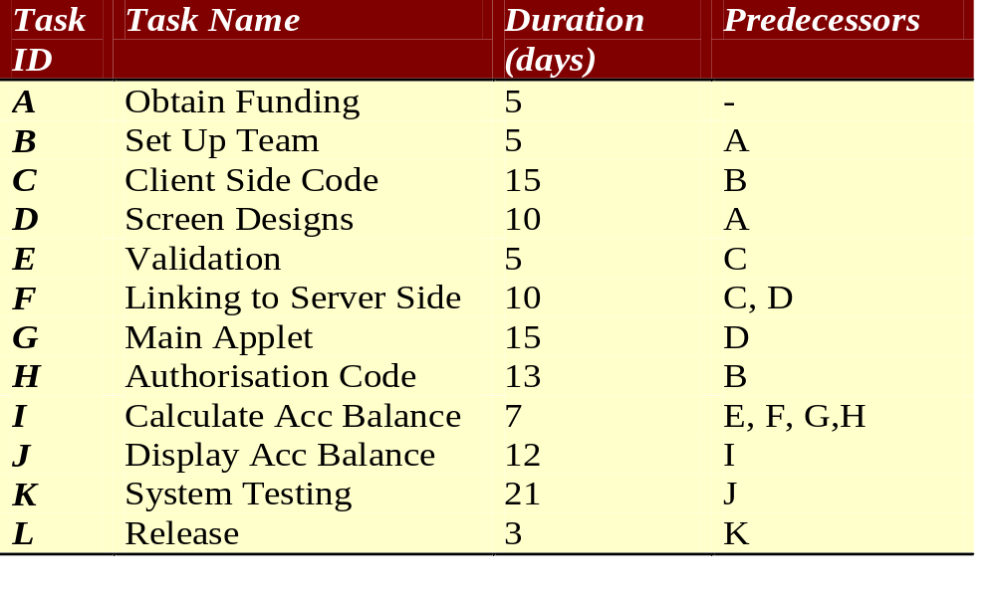
Confirm tasks and their predecessors

Slide 40
Network Analysis - durations
ES
D
EF
13
H
5
Start
3
5
E
LS
F
LF
L
B
ES = Earliest Start
D = Duration
EF = Earliest Finish
LS = Latest Start
F = Float
LF = Latest Finish
15
10
C
F
21
0
0
0
5
K
Start
A
15
0
0
0
G
10
7
12
Include the information we have...
D
I
J

Slide 41
Network Analysis – ES & EF
ES
D
EF
10
13
23
5
H
Start
3
5
5
10
E
LS
F
LF
L
B
10
15
25
10
C
F
21
0
0
0
0
5
5
K
Start
A
15
0
0
0
G
EF=ES+D
ES is the latest EF of a task’s predecessors
5
10
15
7
12
D
I
J
Work from left to right...

Slide 42
Network Analysis – ES & EF
ES
D
EF
10
13
23
H
25
5
30
Start
75
3
78
5
5
10
E
LS
F
LF
L
B
10
15
25
25
10
35
C
F
54
21
75
0
0
0
0
5
5
K
Start
A
15
15
30
0
0
0
G
EF=ES+D
ES is the latest EF of a task’s predecessors
5
10
15
35
7
42
42
12
54
D
I
J
Work from left to right...

Slide 43
Network Analysis – LS & LF
ES
D
EF
10
13
23
H
25
5
30
Start
75
3
78
5
5
10
22
35
E
LS
F
LF
L
B
30
35
75
78
5
10
10
15
25
25
10
35
C
F
54
21
75
0
0
0
10
25
25
35
K
0
5
5
15
15
30
54
75
Start
A
0
0
0
0
5
G
20
35
Work back from right to left... Assume we want to finish as soon as possible...
5
10
15
LF of preceding task = earliest LS of following tasks.
LS = LF – D.
35
7
42
42
12
54
D
I
J
10
20
35
42
42
54

Slide 44
Network Analysis –Float & Critical Path
ES
D
EF
10
13
23
H
25
5
30
Start
75
3
78
5
5
10
22
12
35
E
LS
F
LF
L
B
30
5
35
75
0
78
5
0
10
10
15
25
25
10
35
C
F
54
21
75
0
0
0
0
5
5
10
0
25
25
0
35
K
Start
A
15
15
30
54
0
75
0
0
0
0
0
5
G
F = LF – EF.
Critical Path = the path (to finish the project) along which all tasks are critical: i.e. there is no spare time on the CP (float F = 0 throughout).
20
5
35
5
10
15
35
7
42
42
12
54
D
I
J
10
5
20
35
0
42
42
0
54

Slide 45
Quality Metrics
Defect Removal Efficiency
  DRE = E/(E+D)
    E = No. Errors, before delivery
    D = No. Defects after delivery
    Measures how good you are at quality assurance
    DRE should be 1
    (i.e. All errors detected and resolved,
    and no defects reported after delivery)
Defects per kLOC
  C = No. Defects/ kLOC
    Defect = lack of conformance to a requirement
    Measures correctness

Slide 46
Quality Metrics
Integrity
  A system’s ability to withstand attacks
  (incl. Accidental ones) on its security
  I = Σ [1 - threat × (1- security)]
  threat = probability that an attack
  of a particular type will occur at a given time
  security = probability that an attack
  of that type will be repelled – e.g.
  Sum of
  [1 - threat × (1 - security)]
    [1 – 0.10 × (1 - 0.99)] = 0.999 +
    [1 – 0.50 × (1 – 0.85)] = 0.925 +
    [1 – 0.75 × (1 – 0.90)] = 0.925
Level of integrity for 3 threat types is 2.849

Slide 47
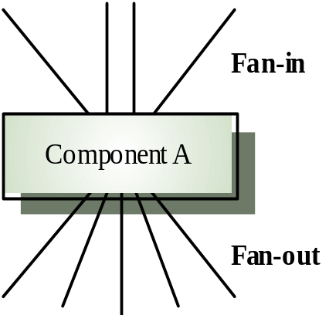

Quality Metrics
Design Complexity
  'fan-in and fan-out' in a structure chart.
  High fan-in (number of calling functions) = high coupling
  High fan-out (number of calls) = high coupling (complexity).
  Length is any measure of program size such as LOC
  Complexity = Length * (Fan-in * Fan-out)²
  (Henry & Kafura, 1990)
Other metrics include
  Cyclomatic complexity: the complexity of program control
  Length of identifiers
  Depth of conditional nesting
  For supporting documentation: the Gunning Fog Index based on length of sentences and no. of syllables
  (complex words have 3+ syllables):

Slide 48
Requirements Engineering

Slide 49
How are requirements elicited?
Interviews
  Gives best information
  expensive
Questionnaires
  Good if many people involved especially if dispersed
  Tend to have poor responses
Observation
  Accurate if done well
  Expensive
Joint Application Design
  Typically workshops with users to get a consensus of the requirements

Slide 50
Typical Requirements Elicitation Process
Identify actors
  types of user (including other systems) who interact with the system
Identify scenarios
  concrete examples of how the system will be used
  Used to communicate with users about the requirements for the system
Identify use cases
  Description of all possible behaviour in the system
  These are abstractions unlike scenarios which are specific examples
Refine use cases
  Ensure completeness including exceptions/error paths
Identify Relationships among use cases
  Factor out common functionality
  Find dependencies (more later on this)
Identify Non-functional requirements

Slide 51
Software Design

Slide 52
Example - Problem Statement for ATM
Design the software to support a computerised banking network including both human cashiers and automated teller machines (ATMs) to be shared by a consortium of banks. Each bank provides its own computer to maintain its own accounts and process transactions against them. Cashier stations are owned by individual banks and communicate directly with their own bank computers. Human cashiers enter account and transaction data. ATM’s communicate with a central computer which clears transactions with the appropriate banks. an ATM accepts a cash card, interacts with the user, communicates with the central system to carry out the transaction, dispenses cash and prints receipts. The system requires appropriate record keeping and security provisions. The system must handle concurrent accesses to the same account correctly. The banks will provide their own software for their own computers; you are to design the software for the ATM’s and the network. The cost of the shared system will be apportioned to the banks according to the number of customers with cash cards.
Ref: Raumbaugh et al. Object Oriented Modeling and Design, Prentice Hall, 1991.

Slide 53
Identifying Entity Objects
Abbott’s* mapping scheme
  Proper noun ⇒ instance e.g. “Alice”
  Common Noun ⇒ class e.g. Field Officer, Incident,…
  Doing Verb ⇒ Operation e.g. Create, submit, …
  Being Verb ⇒ Inheritance e.g. is a, is a kind of, is one of…
  Having Verb ⇒ Aggregation e.g. Has, consists, includes …
  Modal verb ⇒ Constraints e.g. must be
  Adjective ⇒ Attribute e.g. Incident description, location,…
BUT English isn’t quite so straightforward
  For class identification, eliminate the
    redundant
    irrelevant – details unrelated to the problem
    vague - ill-defined, very broad concepts
    attributes - things that describe an object (but may be attributes of a class)
    operations - things that manipulate objects (but may be method calls)
    implementation constructs
*Russell J. Abbott (Computer Science, California State University). 1983.
Program design by informal English descriptions. Commun. ACM 26, 11 (November 1983), 882-894.

Slide 54
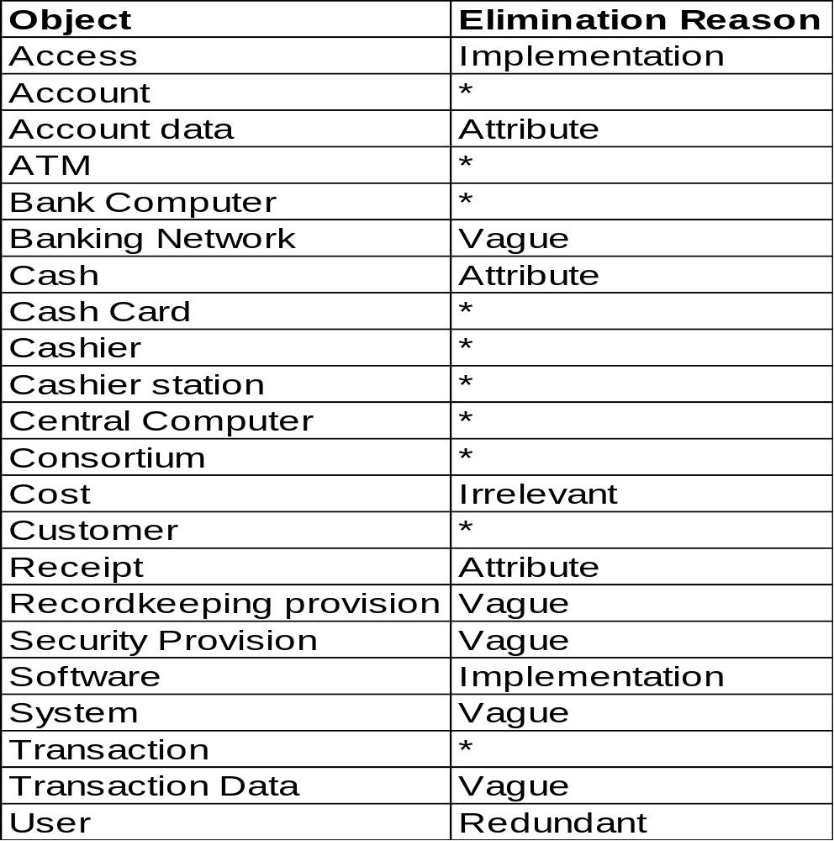
Object modelling - keeping the right classes
KEEP:
Account,
ATM,
Bank,
Bank Computer,
Cash Card,
Cashier,
Cashier Station,
Central Computer, Consortium, Customer,
Transaction

Slide 55
ATM - Identify Associations
  Associations correspond to verbs in the problem statement
  Association = any dependency between two classes
  from verb phrases involving identified classes
    consortium shares ATMs
    bank provides bank computer
    bank computer maintains accounts etc...
  or from implicit verb phrases
    consortium consists of banks
    bank holds account etc...
  or from knowledge of the problem domain
    cash card accesses accounts
    bank employs cashiers

Slide 56
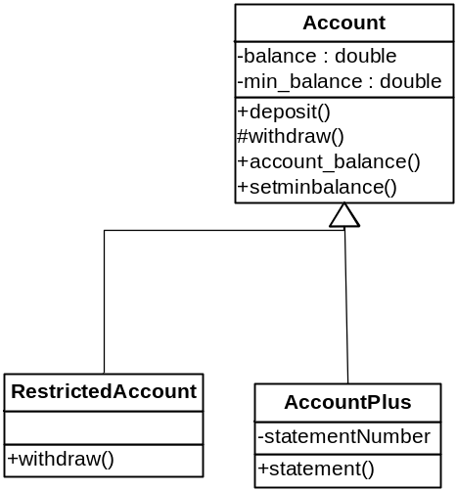
Overriding a superclass method
As well as inheriting methods from a superclass, a subclass can override a superclass method.
e.g. Restricted_Account = same as Account but only 3 withdrawals allowed per year
class Restricted_Account extends Account
{ private static final int MAX_WITHDRAWALS = 3;
private int num_withdrawals_left = 0;
public void reset()
{ num_withdrawals_left = MAX_WITHDRAWALS;
}
public double withdraw (final double amount)
{ if (num_withdrawals_left>0)
{ num_withdrawals_left = num_withdrawals_left - 1;
return super.withdraw(amount);
}
else return 0.0;
}
}
AccountPlus
-statement_no
-account_name
+statement()
Run the superclass method

Slide 57
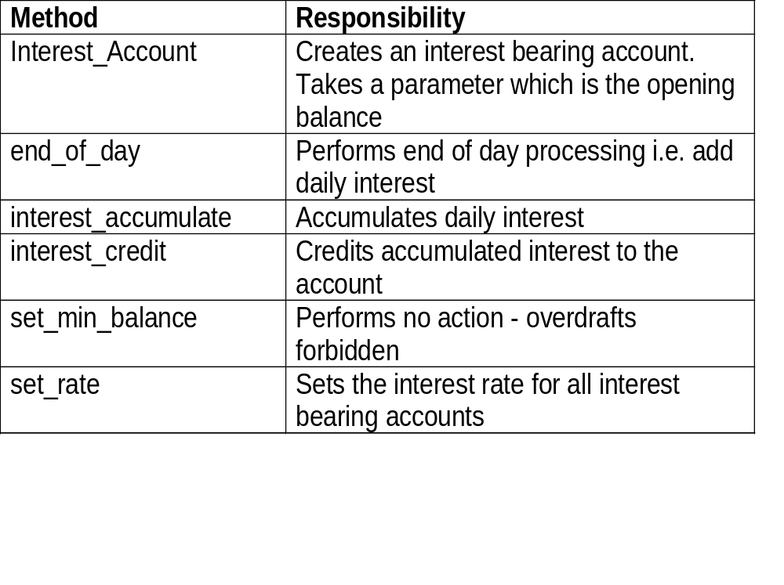
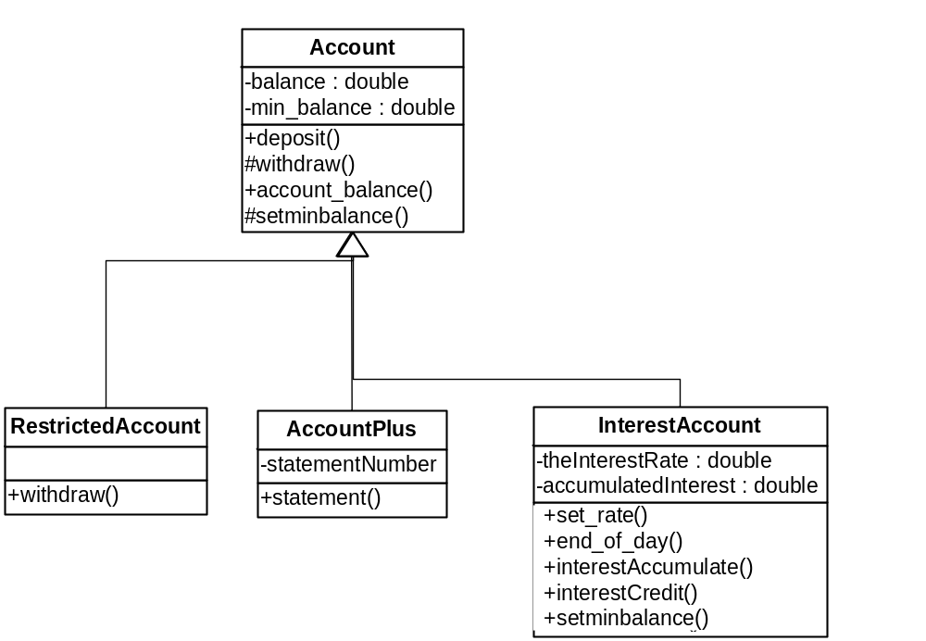
Case Study: Interest bearing Account
AccountPlus
-statement_no
-account_name
+statement()
Interest_Account
-the_interest_rate: double
-the_accumulated_interest
+set_rate()
+end_of_day()
#interest_accumulate()
+interest_credit()
+set_min_balance()

Slide 58
Interest bearing Account
Constructors
But we might want to open an account with a deposit
public Interest_Account()
{ the_accumulated_interest = 0.0;
}
public Interest_Account(final double initial)
{ this(); //Constructor in this class
deposit( initial ); //Set initial amount
}
In this example, this( ) has effect of calling the constructor InterestAccount( )

Slide 59
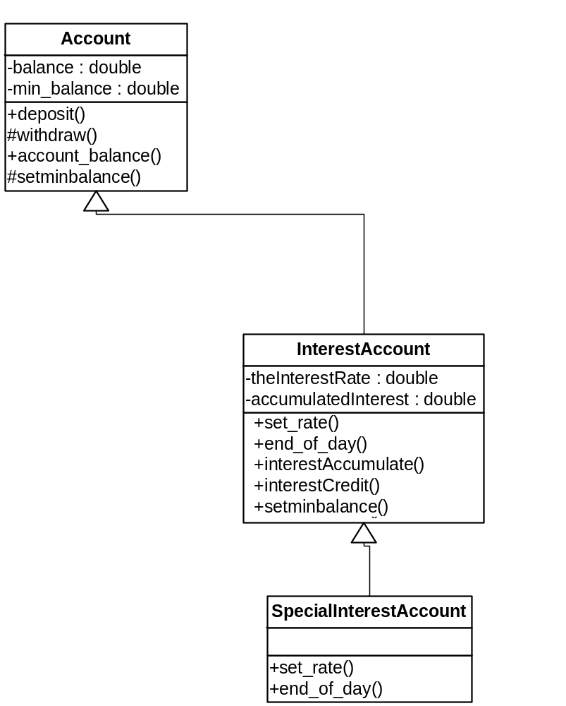
Special Interest Bearing Account
SpecialInterestAccount extends InterestAccount
2 rates of interest - 1 for deposits of £1000+, a lower rate for those £1000
Method | Responsibility
Special_Interest_Account | Creates a special interest account. A single parameter indicates the opening balance.
set_rate | Sets the interest rate for all special interest bearing accounts
end_of_day | Performs end-of-day processing - calculates interest gained
Interest_Account
-the_interest_rate: double
-the_accumulated_interest
+set_rate()
+end_of_day()
#interest_accumulate()
+interest_credit()
+set_min_balance()
Special_Interest_Account
+set_rate()
+end_of_day()

Slide 60
Special Interest Bearing Account
Constants class
Constructors
class SIA_Const
{ public static final double R1 = 0.00026116; //10%
public static final double R2 = 0.00028596; //11%
}
Calls superclass constructor
public Special_Interest_Account()
{
}
public Special_Interest_Account( final double initial )
{
super( initial ); //Constructor in Interest_Account
}

Slide 61
Software Design Quality
Notes:
Things you should look up:
Pressman - chapter’s 1 & 2

Slide 62
Coupling and Cohesion
Cohesion: how well does a module fit together
Coupling: how dependent is one module on another
Cohesion is good
Coupling is bad
Why?
What sort of things cause
poor cohesion/high coupling?
Module Y
Coupling
Module X
(Cohesion)
Module Z

Slide 63
Cohesion
Interaction within a module is a measure of how well that module 'fits together'
High cohesion: the module implements a single logical entity or function
Cohesion is a desirable quality
  when a change has to be made,
  it is localised within a single module
Why is this good?
  Ease of maintenance
  Possibility of reuse
  The name of the module easily expresses what it does
  The complexity of the interface is reduced

Slide 64
Cohesion levels
Coincidental cohesion (weak)
  Parts of a module are simply bundled together.
    The module is difficult to maintain
    It offers little or no reusability
    In these circumstances modularity offers little advantage
Logical association (weak)
  Elements which perform similar functions are grouped
    The interface is difficult to understand
    The module is difficult to maintain if code for individual tasks
    is related or interconnected
Temporal cohesion (weak)
  Elements which are activated at the same time are grouped
    Tasks may not be not related, so if changes are to be made in this module, other modules may have to be changed also.
    The module’s name may not adequately describe its purpose

Slide 65
Cohesion levels
Procedural cohesion (weak)
  The elements in a module constitute a single control sequence
    Better than temporal cohesion, since all the module’s
    operations are at least logically related, but reusability is limited because
      The single control sequence might relate to a very particular set of circumstances and the sequence of interaction between the elements in the module
      may be unclear
      Since all elements of the module do not necessarily deal with the same data, it may be difficult to maintain the broader system interface to the module
Communicational cohesion (medium)
  All the elements of a module operate
  on the same input or produce the same output
    Better than procedural cohesion, since the module has a clear interface to the broader system, and there is a clear interface between the elements within the module
    But the module may still lack...
Sequential cohesion (medium)
  The output from one part of a module is the input to another part

Slide 66
Cohesion levels
Functional cohesion (strong)
  Each element of a module is necessary for the execution of a single function
Object cohesion (strong)
  Each method within the module (which is a software object) provides functionality which allows object attributes to be modified or inspected

Slide 67
Coupling
A measure of the strength of the interconnections between system modules
Loose coupling means module changes are unlikely to affect other modules
Shared variables or control information exchange lead to tight coupling
Loose coupling can be achieved by state decentralisation (as in objects) and module communication via parameters or message passing (= method calls)
28

Slide 68
Levels of coupling
Good Practice
  Data coupling: data is passed from one module to another using arguments in methods
Bad Practice
  Stamp coupling: more data than necessary is passed via arguments – e.g. pass the whole record instead of just the field being changed
  Control coupling: a flag is passed from one module to another affecting the functionality of the second module
    modules are not independent and so reuse is limited
    the calling module must ‘know’ how the called module works

Slide 69
Levels of coupling
Bad Practice, contd
  Common Coupling: two or more modules access the
  same global (or shared) data
    The resulting code is difficult to read
    There may be side-affects: has another module changed a variable?
    Programs are costly to maintain as a change to a global variable means the whole program has to be searched to find its effect
    Reusability is poor
    Security problems: each module has access to more data than it needs
Module A
Module B
Module C
Module D
Shared Data Area

Slide 70
Levels of coupling
Bad practice, contd
  Content coupling: the calling module can directly modify
  or refer to a data element defined internally in the called module
    Makes maintenance very difficult,
    as the program will be difficult to understand.
    Hint: never allow this type of coupling!
Global data area
A
Content
Coupling
Common Coupling
B
C
D
E

Slide 71
Software Verification
Notes:
Things you should look up:
Pressman - chapter’s 1 & 2

Slide 72
Black-box testing
Approach to testing where the program is considered as a ‘black-box’
The program test cases are based on the system specification
Inputs from test data may reveal anomalous outputs i.e. defects
Test planning can begin early in the software process
Main problem - selection of inputs
  equivalence partitioning
Test cases
Test results
Requirements
Program

Slide 73
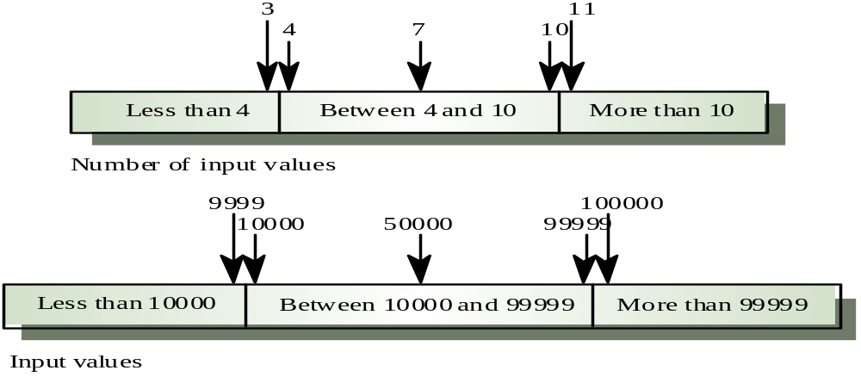
Equivalence partitioning
Partition system inputs and outputs into ‘equivalence sets’
  If an input should be between 4 and 10, choose
    1 number < 4, 1 number between 4-10 and 1 number >10
  If input is a 5-digit integer between 10,000 and 99,999,
  equivalence partitions are
    <10,000, 10,000-99,999 and >= 100,000
Choose test cases at the boundary of these sets

Slide 74
White box testing
Sometimes called structural testing or glass box testing
Derivation of test cases according to program structure.
  Knowledge of the program used to identify additional test cases
Objective is to exercise all program statements
(not all path combinations)
Four types of white-box testing
  Statement Testing – test single statements
  Loop Testing – test loop for
    Execute 0, 1 and n times
  Path Testing – execute every path
  Branch Testing – every outcome from every condition is tested
Test cases
Code Code Code Code Code Code Code Code Code Code Co
de Code Code
Code Code Code Code Code Code Code Code Code Code Code Code Code Code Code Code Code Code Code Code Code Code Code Code Code Code Code Code Code Code Code
Code Code Code Code Code Code Code
Code Code Code Code Code
Code Code Code Code Code Code Code Code Code Code Code Code Code Code Code Code Code Co
de Code Code Code Code Code Code Code Code Code Code Code Code Co
e Code Code Code Co
de Code Code Code Code Code Code Code Code Code
Code Code Code Code Code Code Code Code Code Code Code Code Code Code Code Code Code Code Code Code Code
Code Code Code Code Code Code Code Code Code Code Code Code Code Code Code Code Code Code Code Code Code Code Code Code Code Code Code Code Code Code Code Code Code Code Code Code Code Code Code Code Code Code Code Code Code Code Code Code Code Code Code Code Code Code Code Code Code Code Code Code Code
Test results

Slide 75
Comparison of White- & Black-box
White-box Testing:
  Potentially infinite number of paths have to be tested
  White-box testing often tests what is done, instead of what should be done
  Cannot detect missing use cases
Black-box Testing:
  Potential combinatorial explosion of test cases
  (valid & invalid data)
  Often not clear whether the selected test cases uncover a particular error

Slide 76
Static verification
Verifying the conformance of a software system and its specification without executing the code
Involves analysis of source text by humans or software
on ANY documents produced as part of the software process
Discovers errors early in the software process
2 main techniques
  walkthroughs - 4-6 people examine code & list perceived problems, then meet to discuss
  program inspections (Fagan) - formal approach using checklists
Is this as effective as dynamic testing?
  Usually more cost-effective than testing for defect detection at the unit and module level
  > 60% of program errors can be detected in software inspections

